Slide 1
Business and Industrial Economics
Prof. Luca Grilli
Price discrimination: Part 2

Slide 2
Versioning
 | High WT customers | Low WT customers
Premium Version | 100 | 50
Basic Version | 40 | 30
Number of customers | 40 | 60
Suppose no costs:
Profits with 1° price discrimination: 7.000
Profits with uniform pricing: 5.000
Profits with versioning: 5.400

Slide 3
(The art) To make a profitable Versioning
Key constraint (incentive): Don't make the inexpensive version too attractive to those willing to pay more.
Need to:
Lower price of the premium version
Lower quality of the basic version

Slide 4
Unprofitable versioning
….Look what happens if the basic version is considered acceptable for high-willingness-to pay consumers
 | High WT customers | Low WT customers
Premium Version | 100 | 50
Basic Version | 60 | 30
Number of customers | 40 | 60
Versioning: Profits = 4,600 (p_{basic} = 30)*60 + (p_{premium} = 70)*40
No versioning [uniform price, (p = 50)* 100]: Profits = 5,000

Slide 5
Unprofitable versioning
….Look what happens if the basic version is of too low quality
 | High WT customers | Low WT customers
Premium Version | 100 | 50
Basic Version | 20 | 10
Number of customers | 40 | 60
Versioning: Profits = 4,200 (p_{basic} = 10)*60 + (p_{premium} = 90)*40
No versioning [uniform price, (p = 50)* 100]: Profits = 5,000

Slide 6
2 additional constraints
Additional constraint (participation).
Basic version should be unattractive for high willingness to pay consumers (incentive-compatibility constraint) but of decent quality that those with relatively low but still sufficiently high willingness to pay wish to purchase it (to “be in the market”).
 | High WT customers | Low WT customers
Premium Version | 100 | 50
Basic Version | Very low | Very low
Number of customers | 40 | 60
Versioning is pointless

Slide 7
Additional constraint (good design): impossible for consumers to trasform the basic into the premium version; they need to be really different versions: don’t upset “high-wtp” customers.
See Windows NT case (Shapiro & Varian, 1999, Information rules, p. 64, Chapter 3):
‘Microsoft offers two versions of its Windows NT software: the Windows NT Workstation, which sells for about $260, and the Window NT Server, which sells for $730-$1,080, depending on configuration. Workstation NT can run a Web server but accepts only ten simultaneous sessions; the server version will accept any number of simultaneous sessions. According to an analysis by O'Reilly Software, the two operating systems are essentially the same. In fact, the kernel (the core component of the operating system) is identical in the two products and relatively minor tuning can turn Workstation NT into Server NT. In response to O'Reilly's analysis, Microsoft claimed that the two operating systems differ on more than 700 counts. According to one reporter:
"While the Big 'M' folks in Redmond maintain the products are vastly different, critics allege Workstation can be switched into the Server version with a few easy tweaks. An official Microsoft marketer suggests that's like arguing the only difference between men and women is a Y chromosome. We think it's more akin to discovering your date is indeed a drag queen.“’

Slide 8
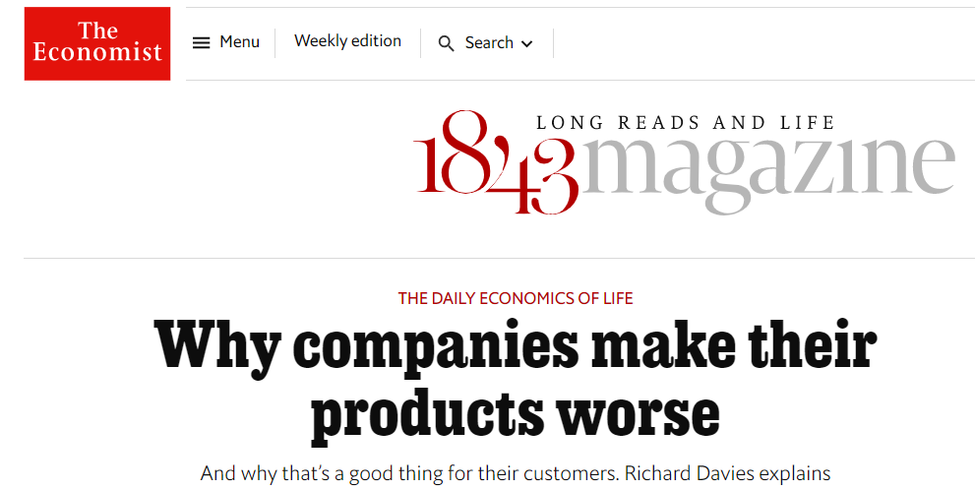
September 15th 2016
“In the late 1980s ibm’s LaserPrinter, retailing at $2,395, printed ten pages per minute. In 1990 it launched the LaserPrinter e. At $1,495 the economy model offered a big discount and printed at half the speed of its pricier sibling. But the new printer was not made using cheaper parts[…]. In fact it was just the original printer with extra inputs: microchips has been added to slow it down. ibm had not designed a low-cost printer, they had spent time and money making their original product worse.”
See also Johnson and David P. Myatt, 2003, Multiproduct Quality Competition: Fighting Brands and Product Line Pruning, American Economic Review, vol. 93 (3), pp. 748-774

Slide 9
See IPhone (Cabral, 2018, p. 136, Chapter 6).
«Bad design» includes «bad timing»
Apple I-Phone first introduced in June 2007: p = 599$.
(Very) Initial success: in the first 30 hrs, Apple sold 270,000.
In September 2007: p = 399$.
Let’s “translate” these elements in our versioning framework
2 months
 | Impatient customers | Patient customers
Immediate Version | 599
Delayed Version | Probably > 399* | 399
Number of customers
2 months
* “If they only knew”: incentive compatibility constraint not respected (if they only knew, they would have never bought the immediate version, and wait)

Slide 10
Steve Jobs’ letter of apologies to customers
“"This is like a slap in the face to early adopters," said John Keck, an executive at an advertising agency in Detroit” (from Wingfield, Wall Street Journal, 2007)
“Before the announcement of the $100 store-credit offer, some iPhone shoppers said the timing of the price cut would discourage them from buying Apple products early in the future.”
(from Wingfield, Wall Street Journal, 2007)
1) To show commitment not to lower price too soon in the future (and build a reputation on that), also to limit risks of a sort of “Coase conjecture” (Coase, 1972, J. of Law and Econ) and 2) in any case, if you use timing for versioning, combine it with other dimensions.
It could be a good idea

Slide 11
Versioning (and PD) and social welfare

Slide 12
????
September 15th 2016
“It might seem like product sabotage should be banned. But it can make customers better off. The key test is whether the practice means more goods are sold. Suppose the French had regulated trains so that all carriages had roofs. All those in second class might have switched to third class, potentially rendering both uneconomical to provide. Altering quality, even if that means damaging goods, can make total supply rise”
General rule of thumb: if price discrimination increases output it can be beneficial. If output does not increase welfare is reduced

Slide 13
Example
 | High WT customers | Low WT customers
Premium Version | 20 | 6
Basic Version | 5 | 5
Number of customers | 100 | 1000
a): 1 version. Best choice: p = 6 (Profits= 6600)
b): 2 versions. Best choices: p_{premium} = 20 and p_{basic} = 5 (Profits = 7000).
N. B. In both cases sold quantity is always 1100, but in b) firm is better off (Producer surplus:+400) and consumers worse off (Consumer surplus: -1400).

Slide 14
But now:
 | High WT customers | Low WT customers
Premium Version | 20 | 6
Basic Version | 5 | 5
Number of customers | 1000 | 100
a): 1 version. Best choice: p = 20 (Profits= 20.000).
b): 2 versions. Best choices: p_{premium}= 20 and p_{basic}= 5 (Profits = 20.500).
N. B. Now in b) also low WT customers enter the market, no reduction in consumer surplus, profits increase, more social welfare.

Slide 15

Slide from previous lecture:
p_{u} = 8 - q_{u}
p_{d} = 5 - q_{d}
p_{T} = 8 - q_{T} for p > 5
p_{T} = 6.5 -0.5q_{T} for p ≤ 5
No fixed costs, MC = 2
Scenario A: price discrimination
f.o.c in U: 8 – 2q_{u} = 2; q_{u} = 3; p_{u} = 5; π_{u} = 9
f.o.c in D: 5 – 2q_{d} = 2; q_{d} = 1.5; p_{d} = 3.5; π_{d} = 2.25
Total π_{ud} (in this case = S^{p}) = 11.25
Total S^{c}: S^{cu} (= 4.5) + S^{cd} (= 1.125) = 5.625
W = 16.875
Scenario B: no price discrimination
f.o.c in T: 6.5 – q_{T} = 2; q_{T} = 4.5; p_{T} = 4.25; π_{T} (again = S^{p}) = 10.125
S^{c} = 4.5 + [(4.5+3)*0.75]/2 = 7.3125
W = 17.4375

Slide 16
Scenario A: price discrimination
f.o.c in U: 8 – 2q_{u} = 2; q_{u} = 3; p_{u} = 5; π_{u} = 9
f.o.c in D: 4 – 2q_{d} = 2; q_{d} = 1; p_{d} = 3; π_{d} = 1
Total π_{ud} (in this case = S^{p}) = 10
Total S^{c}: S^{cu} (= 4.5) + S^{cd} (= 0.5) = 5
W = 15
But suppose now:
p_{u} = 8 - q_{u}
p_{d} = 4 - q_{d}
p_{T} = 8 - q_{T} for p > 4
p_{T} = 6 -0.5q_{T} for p ≤ 4
No fixed costs, MC = 2
Scenario B: no price discrimination
Operating in the downward part of the total demand (p_{T} = 6 – 0.5q_{T}) is not convenient for the firm:
f.o.c: 6 – q_{T} = 2; q_{T} = 4; p_{T} = 4; π_{T} (again = S^{p}) = 8
In this case it will just focus on the uptown market:
f.o.c in U: 8 – 2q_{u} = 2; q_{u} = 3; p_{u} = 5; π_{u} (again = S^{p}) = 9 (> 8)
S^{c} = 4.5
W = 13.5

Slide 17
«VERSIONING»
(on quantity)

Slide 18
Second degree price discrimination (“sort of” versioning on quantity)
Two-part tariff
Tariff entails a fixed entry fee (f) and a per-unit price (p)
Total average unit price depends on quantity
Customers self-select depending on their preferences
Simplifying, it is like having 2 main dichotomous options: a) consume few units (and spend less in absolute terms) but paying a high average price; b) consume more units (and spend more in absolute terms) but paying a lower average price.
Beware of the participation constraint
Excursus: To better meet the participation constraint the seller may also propose different combinations (f,p), i.e. a (relatively) low f and high p for “low” demanders (those who consume few units), and a (relatively) high f and low p for “high” demanders (see the graphical representation in the Appendix)

Slide 19
VERSIONING (functionalities/ product features)
How many versions?
No general rule

Slide 20
More versions: More possibilities to capture value from consumers
More versions:
- More personalization costs (which presumably are convex in the number of versions)
- Risk of “cluttering” effect for potential consumers

Slide 21
To alleviate cluttering (especially when the number of versions increases) many firms think is important to describe functionalities in a very detailed way for each versions
Windows 7

Slide 22
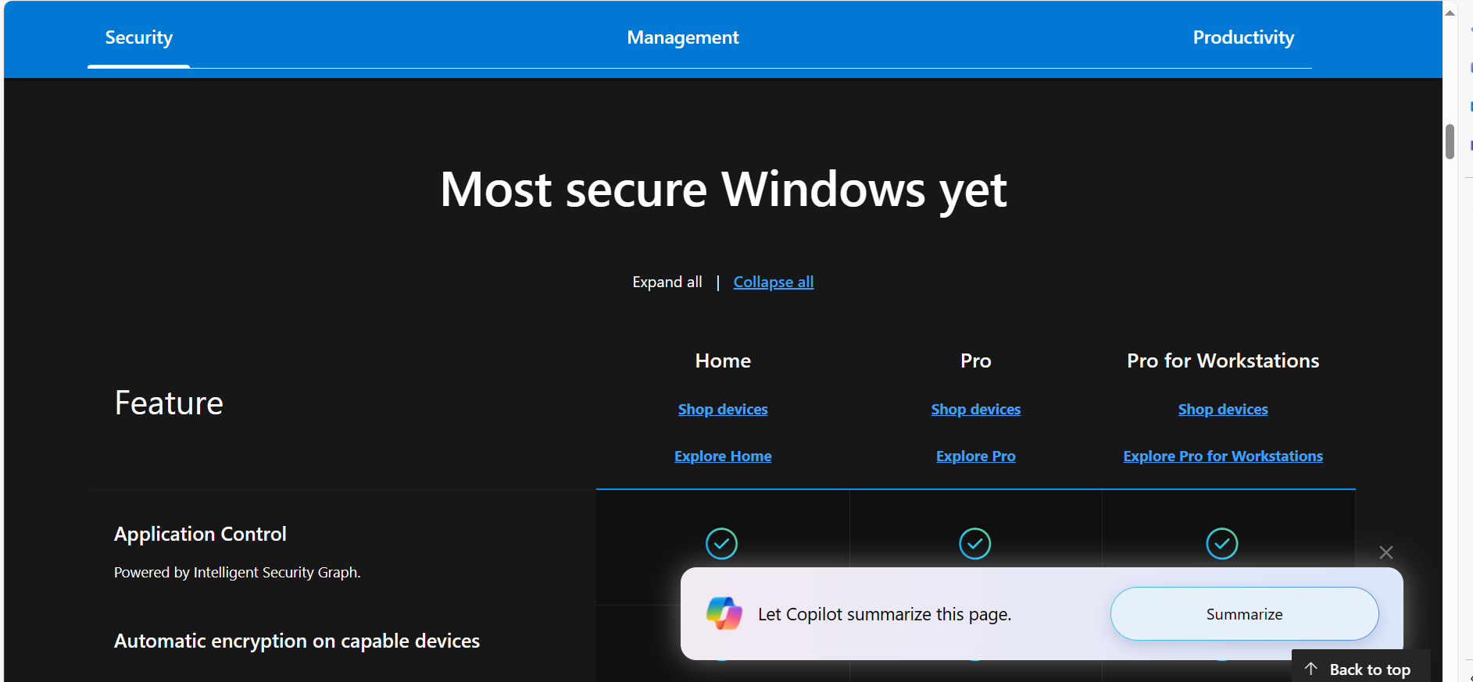
Windows 11

Slide 24


Slide 25
Shapiro and Varian (1999, p. 72):
“If you can't decide how many versions to have, choose three.”
3 can be better than 2 for the phenomenon of “extremeness aversion”: risk that 2 versions (heavy and light) are felt by potential consumers as "too big" or "too small" with the risk that a high percentage will opt for the light version /generating less revenue for the company.
To add another category (super-gold-premium) and make the previous-premium version as the medium one can produce some advantages.

Slide 26
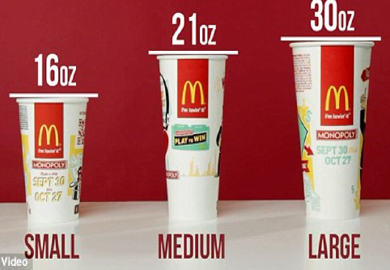
McDonalds
Almost 1 litre: too much
This is by far the size most sold

Slide 27
McDonalds
Will still this size remain the most sold?

Slide 28
Simonson e Tversky experiment (1992, JMR)
Microwave oven. Two possible set of choices for two identical groups of people (n = 60):
- 1° group:
1) basic (Emerson): 110 $ 57% of consumers
2) premium (Panasonic): 180$ 43% of consumers
- 2° group:
basic (same): 110 $ 27%
premium (same): 180$ 60%
High-premium (Panasonic): 200$ 13%

Slide 29


Annotation1: note that with the “extremeness aversion” (and cluttering) argument we are now diverging from the rational “homo oeconomicus” implied by the neoclassical theory who always knows exactly and with no doubt what she/he wants
For an introduction to Behavioral Economics

Slide 30

Annotation 2 «The Economist experiment»
Group 1 (odd personal code)
https://forms.office.com/r/ezfAeTcA4p
Group 2 (even personal code)
https://forms.office.com/r/atubejhYsV

Slide 31
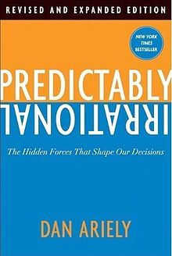
If switching from 2 to 3 is not possible for whatever reason, note that a firm might always artificially increase the number of versions and sell the preferred version exploiting the cognitive biases of consumers Dan Ariely and the Decoy effect (in Predictably Irrational, 2010)

Slide 32
Subscription from The Economist some years ago:
3 versions:
1. on-line subscription for one year and access to all issues from 1997 for US $59,00;
2. Print subscription for one year for US $125,00;
3. Print subscription for one year and on-line access to all issues from 1997 for US $ 125,00.

Slide 33
Ariely’s experiment (2008)
The Economist subscription tested on 100 students from the Sloan School of Management MIT
1. on-line subscription for one year and access to all issues from 1997 for US $59,00: 16 students
2. Print subscription for one year for US $125,00: 0
3. Print subscription for one year and on-line access to all issues from 997 for US $ 125,00: 84

Slide 34
Ariely’s experiment (2008)
The Economist subscription tested on other 100 students from the Sloan School of Management MIT
1. on-line subscription for one year and access to all issues from 1997 for US $59,00: 68 students
3. Print subscription for one year and on-line access to all issues from 997 for US $ 125,00: 32

Slide 35
The Decoy effect
Attribute 1
(e.g. quality)
3
1
Attribute 2
(e.g. price convenience)

Slide 36
The Decoy effect
Attribute 1
(e.g. quality)
3
????? What to choose
1
Attribute 2
(e.g. price convenience)

Slide 37
The Decoy effect
Attribute 1
(e.g. quality)
3
To add a close (to increase comparability) and strictly dominated alternative may help orientate undecided consumers
2
1
Attribute 2
(e.g. price convenience)

Slide 38
Results of our experiment March 7th 2024

Slide 39
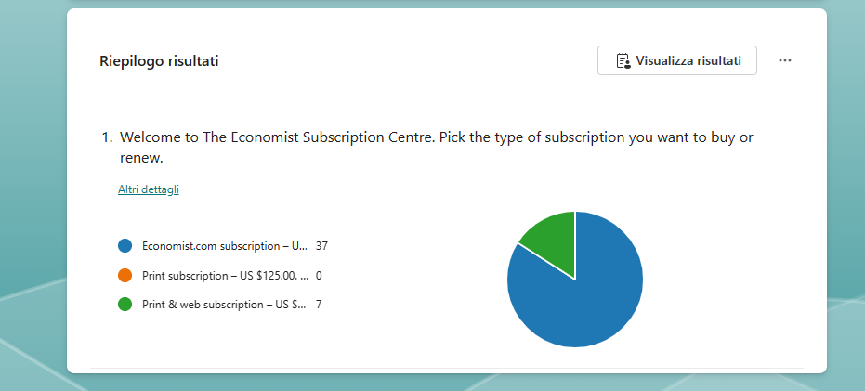
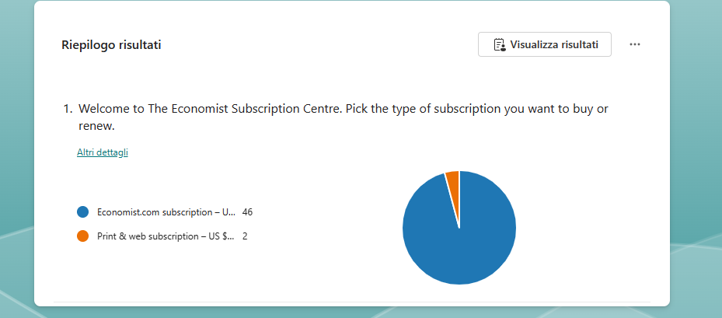
With the “decoy” (n = 44)
Without the “decoy” (n = 48)

Slide 40
History of “The Economist” experiment
Here below you find a comparison of results with the indication of the percentage of students choosing the relative option.
 | 2 options versions |  | The Decoy (3 options version)
 | 1. | 3. | 1. | 2. | 3.
MIT | 68% | 32% | 16% | 0% | 84%
POLIMI BIE 2014/2015 | 86% | 14% | 50% | 0% | 50%
POLIMI BIE 2015/2016 | 64% | 36% | 57% | 3% | 40%
POLIMI BIE 2016/2017 | 72% | 28% | 61% | 7% | 32%
POLIMI BIE 2020/2021 | 82% | 18% | 75% | 1% | 24%
POLIMI BIE 2021/2022 | 89% | 11% | 65% | 4% | 31%
POLIMI BIE 2022/2023 | 94% | 6% | 80% | 0% | 20%
POLIMI BIE 2023/2024 | 96% | 4% | 84% | 0% | 16%

Slide 41
Prospect theory
Generally, individuals (and so consumers) are much more sensitive to losses than to gains
(Utility)
The decoy effect exploits this psychological trait: the average consumer does not know if s/he “wins” by choosing “3” but s/he is sure (or at least more confident) that s/he does not lose by choosing that option.
Kahneman & Tversky (several articles, see in particular to “Choices, values, and frames”, 1984, American Psychologist, 39(4), pp. 341-350)
Thus, more generally, our choices may depend on how outcomes are presented (“framed”) to us. Invariance (and possibly other axioms) of “rational choice” may not hold

Slide 42
1°
(p. 343) “The formulation of Problem 1 implicitly adopts as a reference point a state of affairs in which the disease is allowed to take its toll of 600 lives. The outcomes of the programs include the reference point and two possible gains, measured by the number of lives saved. In this case preferences are risk averse. A clear majority of respondents prefer saving 200 lives for sure over a gamble of that offers a one third chance of saving 600 lives.”
“[…] Now consider another problem in which the same cover story is followed by a different description of the prospects associated with the two programs:
2°
“It is easy to very that options C and D in Problem 2 are undistinguishable in real terms from options A and B in Problem 1, respectively. The second version, however, assumes a reference state in which no one dies for the disease. The best outcome is the maintenance of this state and the alternatives are losses measured by the number of people that will die of the disease.” People in this case are risk seekers.

Slide 43
Appendix

Slide 44
To better meet the participation constraint (each consumer prefer to consume rather than not consuming at all) the seller may also propose different combinations (f,p)
Two types of consumers: type 1 (low demanders) type 2 (high demanders). Below are represented their individual demand curves
Optimal two-part tariff strategy (it can be shown that is):
Menu 1: p1 > MC; f1 = CS1(p1) =
Menu 2: p2 = MC; f 2=
p
2
Why that f2? Seller has to meet the
incentive -compatibility constraint (consumer i prefers menu i to menu j)
1
p1
MC = p2
1
2
q

Slide 45
References
Cabral Industrial Organization I edition, 2000: chapter 10 [or Industrial Organization II edition, 2018: chapter 6.1-6.3].
Varian, Intermediate Microeconomics, chap. 26.7.
Further reading:
Cabral Industrial Organization I edition, 2000: chapter 6.3, 6.4 [or Industrial Organization II edition, 2018: chapter 4.2, 4.3].
Varian, Intermediate Microeconomics, chap. “Monopoly Behavior”, 26.1, 26.2, 26.3, 26.4, 26.5, 26.6)
Shapiro & Varian, Information Rules, chapter 3.

